Slide 1
COMS10003: Dealing with Uncertainty
Probability II: Bayes Theorem
Andrew Calway

Slide 2
Example
1% of women at age forty who participate in routine screening have breast cancer. 80% of women with breast cancer will get positive mammographies. 9.6% of women without breast cancer will also get positive mammographies. If a woman in this age group had a positive mammography, what is the probability that she has breast cancer?

Slide 3
Conditional Probability
We seek the probability that a women has cancer conditioned on the fact that she has a positive mammography

Slide 4
C – cancer
M – positive mammography
W – # women in sample
1% have C
80% of those with C have M
9.6% of those without C have M

Slide 5
For example:
C – cancer
M – positive mammography
W – # women in sample
1% have C
80% of those with C have M
9.6% of those without C have M
1000 women → 10 have C
8 have C and M
990 don’t have C
95 (9.6% of 990) have M but not C
Hence 8 out of 103 (95+8) having M would also have C → 7.8%

Slide 6
C – cancer
M – positive mammography
W – # women in sample
1% have C
80% of those with C have M
9.6% of those without C have M

Slide 7
C – cancer
M – positive mammography
W – # women in sample

Slide 8
C – cancer
M – positive mammography
W – # women in sample
Bayes’ Theorem

Slide 9
Bayes’ Theorem – In General

Slide 10
Priors, Likelihoods and Evidence
likelihood
prior
posterior
evidence

Slide 11
Example
U – unfair
F - fair
You are given the choice of 3 coins. Two are fair and one is unfair such that it always gives H when flipped. If you choose a coin and it gives HHH when flipped three times, what is the probability that it is the unfair coin?
Bayes:

Slide 12
Bayes’ Theorem
U – unfair
F - fair

Slide 13
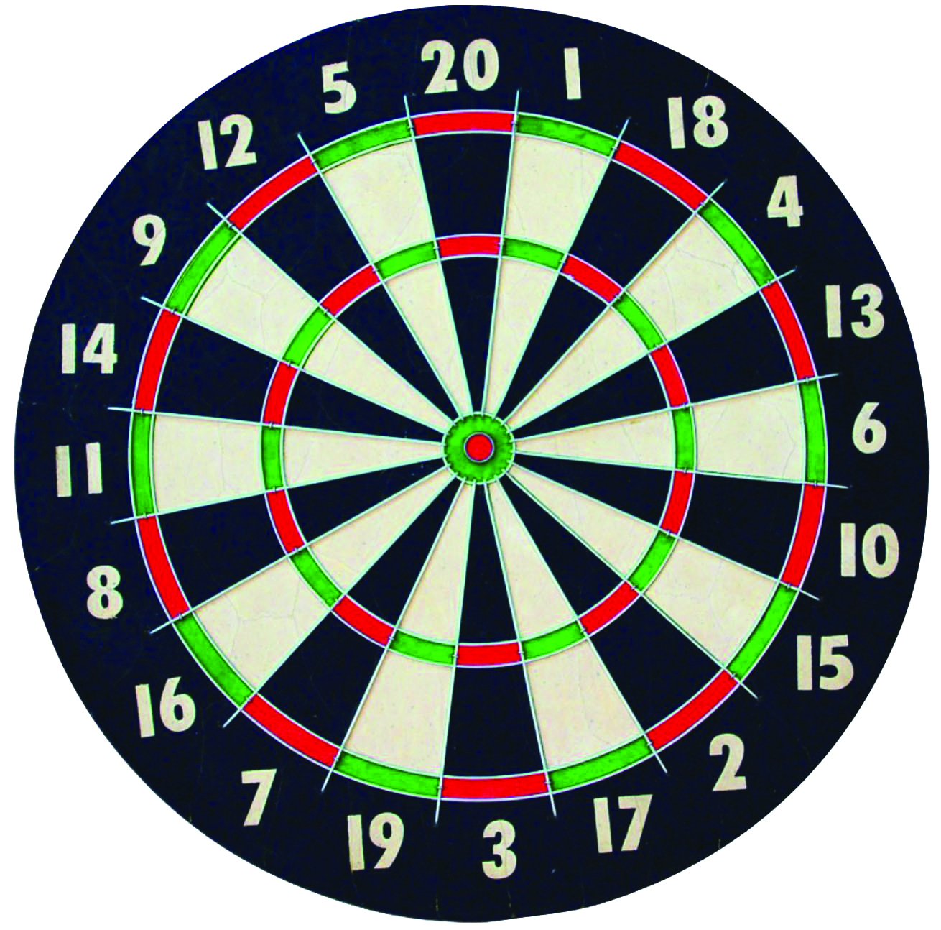
Random Variables
A random variable can have different values taken from a range of possible values
Discrete or continuous, finite or infinite range
Discrete RV:
Throw a dart
Assign x to number
x is RV

Slide 14
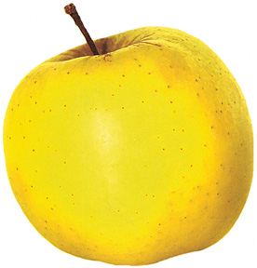
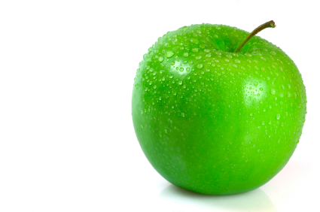
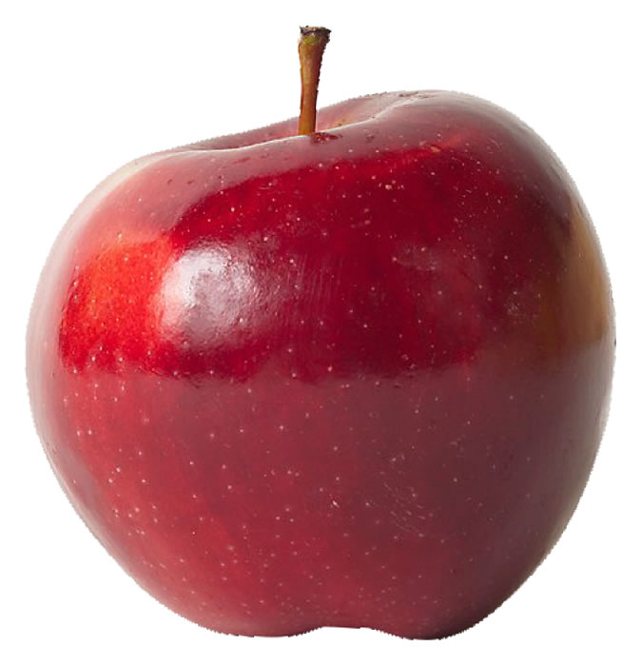
Classifiers
Random
variables
Class
Attribute
Gala
yellow
?
Golden Delicious
green
Granny Smith
red

Slide 15
Supervised Classifier
Training Examples
Variety | Colour
Gala | red
Golden | green
Gala | yellow
Granny | red
Granny | green
Gala | red
Golden | red
Gala | red
Golden | yellow
Granny | green

Slide 16
Naïve Bayes Classifier
Bayes’
Independence (naïve)

Slide 17
Spam Filter
1000 spam, 200 non-spam
word | #spam with word | #non-spam with word
w1 | 500 | 100
w2 | 100 | 80
w3 | 800 | 40
Email with w1 and w2 but not w3 ?
Non-Spam

